Slide 1
Unit 3 Review

Slide 2
What measures the how high or deep the sound is?

Slide 3
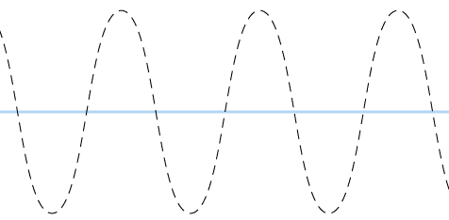
Draw and label this wave for: amplitude, wavelength, crest, and trough.

Slide 4
Look at the information below. Which wave has the lowest wave crests?
Wave | Amplitude (cm) | Wavelength (cm)
A | 12 | 13
B | 20 | 14

Slide 5
What is the highest point of a wave?

Slide 6
What measures how loud or quiet the wave is?

Slide 7
Look at the information below. Which wave has the highest wave crests?
Wave | Amplitude (cm) | Wavelength (cm)
A | 11 | 10
B | 7 | 12

Slide 8
What is the lowest point of a wave?

Slide 9
Which wave has the most energy? Why?
Wave | Amplitude (cm) | Wavelength (cm)
A | 11 | 10
B | 7 | 12

Slide 10
After receiving digital information, your phone does what so you can hear the caller?

Slide 11
When trying to talk to a friend through a thick wall, how can I optimize a solution to my problem? change my original criteria or test several possible solutions

Slide 12
If a wave isn't very tall and not far apart the wave has ___________ amplitudes and ___________ wave lengths.

Slide 13
Which wave has the most energy? Why?
Wave | Amplitude (cm) | Wavelength (cm)
A | 12 | 13
B | 20 | 14

Slide 14
When you answer your phone, what is your phone is receiving __________ ___________________ first.

Slide 15
Which is better for sending messages over long distances: radio waves or digital? Two reasons to support your answer.

Slide 16
Why do engineers produce several different solutions to a single problem?

Slide 17
Two boys used morse code at camp to communicate. They used dashes and dots, and a flash light. One morning the boy ask his friend to meet him at the park at 10:00. Although the boy said okay, he never showed up. What could have happened? What advise could you give the boys about their code?

Slide 18
____ The radio signal is picked up by the nearest cell tower in your network.
_____ The phone converts the sound of your voice into digitized form.
__5__ The tower redirects the signal through the network to your friend’s phone. _______You talk into your cell phone.
_____ Your friend’s phone converts the digitized information back into the sound of your voice.
__3__ The digital code is transmitted as a radio signal.

